Slide 1


Uncovering patterns in the Dublin Marathon 2019
Daniel Rodriguez – x18142907

Slide 2
RQ1: What is the best age category to run the Dublin Marathon?
RQ2: Does joining a running club affect performance?
RQ3: What race segment is the most important to succeed in this event?

Slide 3
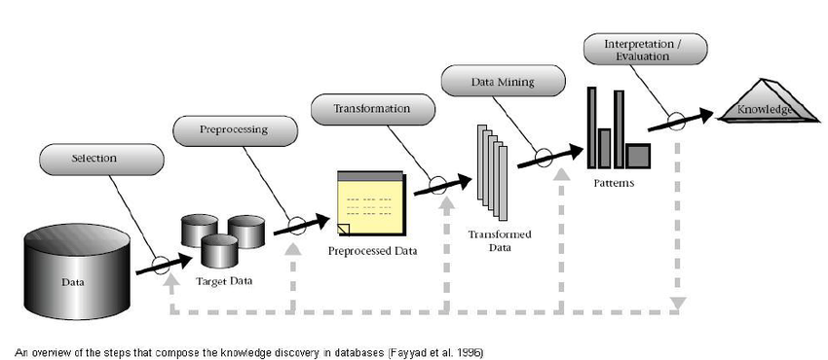
KDD methodology

Slide 4
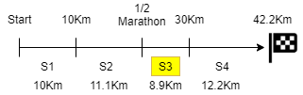
RQ1:
“Age35” -> Prime
“Age40”
“Under19s”
RQ2: Join a club = better ranking
RQ3:
No difference from Seniors (Age19-34)

Slide 5
THANK YOU
Any questions?
Vikas: Please go back to the Age category results – “RQ1”
Answer: Due to the dummy encoding performed on the age category variable, the regression compares all the categories against the senior runners(Age19-34), which is the baseline group.
Taking the above into account:
“Age35” category performed better than seniors.
No difference in performance in “Age40” compared to seniors.
Also, Under19s (“Age18”) were no likely the perform different than seniors.
All remaining categories: “Age45”, “Age50”… did perform differently (worse, in this case) than seniors. Therefore age hampered performance in these runners.

